Slide 1
Accounting and Financials
Barringer Chapter 8
Notes:
https://www.youtube.com/watch?v=opNiKBP7hQo https://www.youtube.com/watch?v=1gg2vXq-1VI 2"00 Paul Graham https://www.youtube.com/watch?v=2lcp0uZsY7k

Slide 2
Pricing

Slide 3
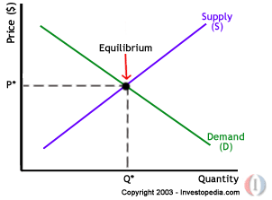
AREC 213 Lecture 6
Pricing Your Product
How much Should you Charge
You must cover your costs
People must be willing to pay
High or low price you must provide Value to your customer.
No matter what strategy you employ to determine your price, you always know all your costs
Notes:
We’ve seen that the demand and supply of goods react to changes in price, and that prices in turn move along with changes in quantity. We’ve also seen that the utility, or satisfaction received from consuming or acquiring goods diminishes with each additional unit consumed. The degree to which demand or supply reacts to a change in price is called elasticity.
Elasticity varies from product to product because some products may be more essential to the consumer than others. Demand for products that are considered necessities is less sensitive to price changes because consumers will still continue buying these products despite price increases. On the other hand, an increase in price of a good or service that is far less of a necessity will deter consumers because the opportunity cost of buying the product will become too high.
A good or service is considered highly elastic if even a slight change in price leads to a sharp change in the quantity demanded or supplied. Usually these kinds of products are readily available in the market and a person may not necessarily need them in his or her daily life, or if there are good substitutes. For example, if the price of Coke rises, people may readily switch over to Pepsi. On the other hand, an inelastic good or service is one in which large changes in price produce only modest changes in the quantity demanded or supplied, if any at all. These goods tend to be things that are more of a necessity to the consumer in his or her daily life, such as gasoline.
To determine the elasticity of the supply or demand of something, we can use this simple equation:
Elasticity = (% change in quantity / % change in price) If the elasticity is greater than or equal to 1, the curve is considered to be elastic. If it is less than one, the curve is said to be inelastic.
As we saw previously, the demand curve has a negative slope. If a large drop in the quantity demanded is accompanied by only a small increase in price, the demand curve will appear looks flatter, or more horizontal. People would rather stop consuming this product or switch to some alternative rather than pay a higher price. A flatter curve means that the good or service in question is quite elastic.

Slide 4

AREC 213 Lecture 6
Pricing Your Product
You can only spend money you have built into your price
Discounts, coupons, rebates, loyalty programs all need to be considered when setting your price
Your Price Must allow you to cover all costs and ideally be able to make a profit (net income)
Value is what your customer believes your product is worth
Price is the amount of money you charge your customers per sales unit of your product

Slide 5
AREC 213 Lecture 6
OLD BELOW
Notes:
You can only spend money you have built into your price.
Discounts, coupons, rebates, loyalty programs all need to be considered when setting your price.

Slide 6
AREC 213 Lecture 6
Industry and Market
Markets
Consist of Customers (Buyers)
People or Businesses Willingness to Buy Ability to Buy
Unsatisfied or Unmet Needs
Industry
Consists of Sellers
Companies producing goods or services
Located somewhere in the Value Chain
In search of customers

Slide 7
AREC 213 Lecture 6
Importance
What is Industry Analysis
Industry
An industry is a group of firms producing a similar product or service, such as logging, hunting and fishing, airlines, fitness drinks, furniture, or electronic games.
Industry Analysis is business research that focuses on the potential of an industry.
BLS
Once it is determined that a new
venture is feasible in regard to the
industry and market in which it
will compete, a more in-depth
analysis is needed to learn the ins
and outs of the industry.
The analysis helps a firm determine
if the target market it identified
during feasibility analysis is
favorable for a new firm.

Slide 8
AREC 213 Lecture 6
Three Key Questions
When studying an industry, an entrepreneur must answer three questions before pursuing the idea of starting a firm.
Is the industry
accessible—in other
words, is it is realistic
place for a new
venture to enter?
Question 1
Does the industry
contain markets that
are ripe for innovation
or are underserved?
Question 2
Are there positions in
the industry that avoid
some of the negative
attributes of the
industry as a whole?
Question 3
Notes:
Accessible
Ready for innovation or underserved
Avoid negative aspects as a whole

Slide 9


AREC 213 Lecture 6
How Industry and Firm-Level Factors Affect Performance
Firm-Level Factors
Include a firm’s assets, products, culture, teamwork among its employees, reputation, and other resources.
Industry-Level Factors
Include threat of new entrants, rivalry among existing firms, bargaining power of buyers, and related factors.
Conclusion
In various studies, researchers have found that from 8% to 30% of the variation in firm profitability is directly attributable to the industry in which a firm competes.
Firm factors can play a major role on the success of a firm,

Slide 10
AREC 213 Lecture 6
Assessing Industry Attractiveness
Study Environmental
and Business Trends
The Five Competitive
Forces Model

Slide 11
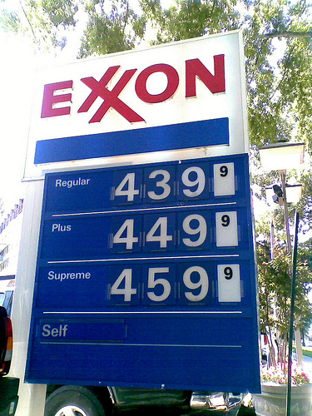
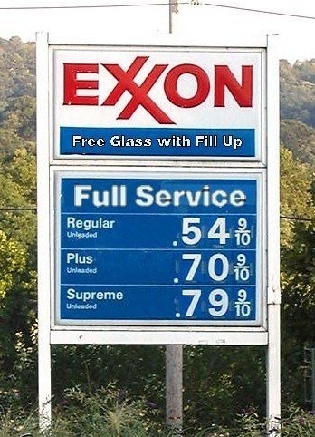
AREC 213 Lecture 6
Studying Industry Trends
Environmental Trends
Include economic trends, social trends, technological advances, and political and regulatory changes.
For example, industries that sell products to seniors are benefited by the aging of the population.
Business Trends
Other trends that impact an industry.
For example, are profit margins in the industry increasing or falling?
Is innovation accelerating or waning?
Are input costs going up or down?
A trend over the last 30 years is the increase in gas prices
Negative: Logistics, Trucking, Farming
Positive: Tesla

Slide 12
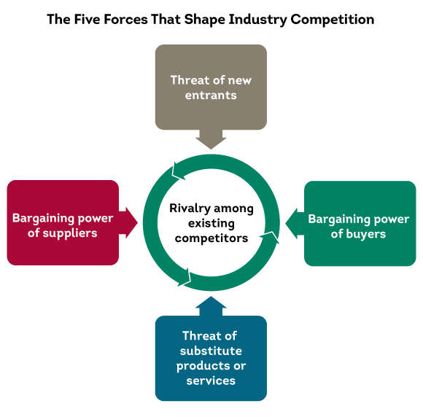
AREC 213 Lecture 6
Porters Five Forces Model
Explanation of the Five Forces Model
The five competitive forces model is a framework for understanding the structure of an industry.
The model is composed of the forces that determine industry profitability.
They help determine the average rate of return for the firms in an industry.
Each of the five forces impacts the average rate of return for the firms in an industry by applying pressure on industry profitability.
Well managed firms try to position their firms in a way that avoids or diminishes these forces—in an attempt to beat the average rate of return of the industry.

Slide 13
AREC 213 Lecture 6
Threat of Substitutes
The price that consumers are willing to pay for a product depends in part on the availability of substitute products.
For example, there are few if any substitutes for prescription medicines, which is one of the reasons the pharmaceutical industry is so profitable.
In contrast, when close substitutes for a product exist, industry profitability is suppressed, because consumers will opt out if the price gets too high.

Slide 14
AREC 213 Lecture 6
Threat of Substitutes
The extent to which substitutes suppress the profitability of an industry depends on the propensity for buyers to substitute between alternatives.
This is why firms in an industry often offer their customers amenities to reduce the likelihood that they will switch to a substitute product, even in light of a price increase.

Slide 15
AREC 213 Lecture 6
Threat of New Entrants
If the firms in an industry are highly profitable, the industry becomes a magnet to new entrants.
Unless something is done to stop this, the competition in the industry will increase, and average industry profitability will decline.
Firms in an industry try to keep the number of new entrants low by erecting barriers to entry.
A barrier to entry is a condition that creates a disincentive for a new firm to enter an industry.

Slide 16
AREC 213 Lecture 6
Threat of New Entrants
Barriers to Entry:
Barrier to Entry
Explanation
Industries that are characterized by large economies of scale are difficult for new firms to enter, unless they are willing to accept a cost disadvantage.
Economies of Scale
Industries such as the soft drink industry that are characterized by firms with strong brands are difficult to break into without spending heavily on advertising.
Product differentiation
Capital requirements
The need to invest large amounts of money to gain entrance to an industry is another barrier to entry.

Slide 17
AREC 213 Lecture 6
Threat of New Entrants
Barriers to Entry (cont)
Barrier to Entry
Explanation
Existing firms may have cost advantages not related to size. For example, the existing firms in an industry may have purchased land when it was less expensive than it is today.
Cost advantages independent of size
Distribution channels are often hard to crack. This is particularly true in crowded markets, such as the convenience store market.
Access to distribution channels
Government and legal barriers
Some industries, such as broadcasting, require the granting of a license by a public authority to compete.

Slide 18
AREC 213 Lecture 6
Threat of New Entrants
Barriers to Entry
Nontraditional Barriers to Entry
It is difficult for start-ups to execute barriers to entry that are expensive, such as economies of scale, because money is usually tight.
Start-ups have to rely on nontraditional barriers to entry to discourage new entrants, such as assembling a world-class management team that would be difficult for another company to replicate.

Slide 19
AREC 213 Lecture 6
Threat of New Entrants
Nontraditional Barriers to Entry
Barrier to Entry
Explanation
If a start-up puts together a world-class management team, it may give potential rivals pause in taking on the start-up in its chosen industry.
Strength of management team
If a start-up pioneers an industry or a new concept within an industry, the name recognition the start-up establishes may create a barrier to entry.
First-mover advantage
If the employees of a start-up are motivated by the unique culture of a start-up, and anticipate a large financial reward, this is a combination that cannot be replicated by larger firms.
Passion of the management team and employees

Slide 20
AREC 213 Lecture 6
Threat of New Entrants
Nontraditional Barriers to Entry (cont)
Barrier to Entry
Explanation
If a start-up is able to construct a unique business model and establish a network of relationships that makes the business model work, this set of advantages creates a barrier to entry.
Unique business model
Some Internet domain names are so “spot-on” that they give a start-up a meaningful leg up in terms of e-commerce opportunities.
Internet domain name
Inventing a new approach to an industry
If a start-up invents a new approach to an industry and executes it in an exemplary fashion, these factors create a barrier to entry for potential imitators.

Slide 21
AREC 213 Lecture 6
Rivalry Among Existing Firms
In most industries, the major determinant of industry profitability is the level of competition among existing firms.
Some industries are fiercely competitive, to the point where prices are pushed below the level of costs, and industry-wide losses occur.
In other industries, competition is much less intense and price competition is subdued.

Slide 22
AREC 213 Lecture 6
Rivalry Among Existing Firms
Number and balance of competitors
The more competitors there are, the more likely it is that one or more will try to gain customers by cutting its price.
Degree of difference between products
The degree to which products differ from one product to another affects industry rivalry.

Slide 23
AREC 213 Lecture 6
Rivalry Among Existing Firms
The competition among firms in a slow-growth industry is stronger than among those in fast-growth industries.
Growth rate of an industry
Firms that have high fixed costs must sell a higher volume of their product to reach the break-even point than firms with low fixed costs.
Level of fixed costs

Slide 24
AREC 213 Lecture 6
Bargaining Power of Suppliers
Suppliers can suppress the profitability of the industries to which they sell by raising prices or reducing the quality of the components they provide.
If a supplier reduces the quality of the components it supplies, the quality of the finished product will suffer, and the manufacturer will eventually have to lower its price.
If the suppliers are powerful relative to the firms in the industry to which they sell, industry profitability can suffer

Slide 25
AREC 213 Lecture 6
Bargaining Power of Suppliers
Factors that have an impact on the ability of suppliers to exert pressure on buyers
Supplier concentration
When there are only a few suppliers that supply a critical product to a large number of buyers, the supplier has an advantage.
Switching costs are the fixed costs that buyers encounter when switching or changing from one supplier to another. If switching costs are high, a buyer will be less likely to switch suppliers.
Switching costs

Slide 26
AREC 213 Lecture 6
Bargaining Power of Suppliers
Factors that have an impact on the ability of suppliers to exert pressure on buyers
Attractiveness of substitutes
Supplier power is enhanced if there are no attractive substitutes for the product or services the supplier offers.
Threat of forward integration
The power of a supplier is enhanced if there is a credible possibility that the supplier might enter the buyer’s industry.

Slide 27
AREC 213 Lecture 6
Bargaining Power of Buyers
Buyers can suppress the profitability of the industries from which they purchase by demanding price concessions or increases in quality.
For example, the automobile industry is dominated by a handful of large companies that buy products from thousands of suppliers in different industries. This allows the automakers to suppress the profitability of the industries from which they buy by demanding price reductions.

Slide 28
AREC 213 Lecture 6
Bargaining Power of Buyers
Factors that have an impact on the ability of suppliers to exert pressure on buyers
If there are only a few large buyers, and they buy from a large number of suppliers, they can pressure the suppliers to lower costs and thus affect the profitability of the industries from which they buy.
Buyer group concentration
The greater the importance of an item is to a buyer, the more sensitive the buyer will be to the price it pays.
Buyer’s costs

Slide 29
AREC 213 Lecture 6
Bargaining Power of Buyers
Factors that have an impact on the ability of suppliers to exert pressure on buyers
Degree of standardization of supplier’s products
The degree to which a supplier’s product differs from its competitors affects the buyer’s bargaining power.
Threat of backward integration
The power of buyers is enhanced if there is a credible threat that the buyer might enter the supplier’s industry.

Slide 30
AREC 213 Lecture 6
First Application of the Model
The five forces model can be used to assess the attractiveness of an industry by determining the level of threat to industry profitability for each of the forces.
If a firm fills out the form shown on the next slide and several of the threats to industry profitability are high, the firm may want to reconsider entering the industry or think carefully about the position it would occupy.

Slide 31
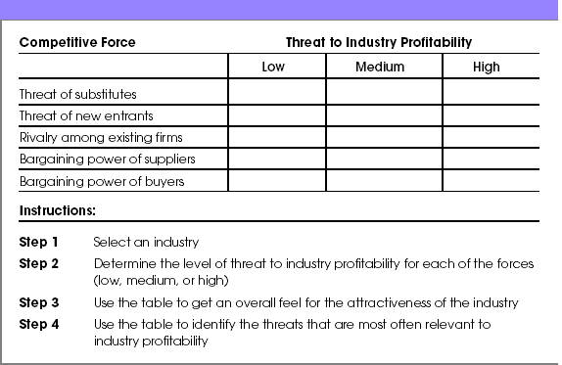
AREC 213 Lecture 6
Assessing Industry Attractiveness Using the Five Forces Model

Slide 32
AREC 213 Lecture 6
Second Application of the Model
The second way a new firm can apply the five forces model to help determine whether it should enter an industry is by using the model to answer several key questions.
The questions are shown in the figure on the next slide, and help a firm project the potential success of a new venture in a particular industry.

Slide 33
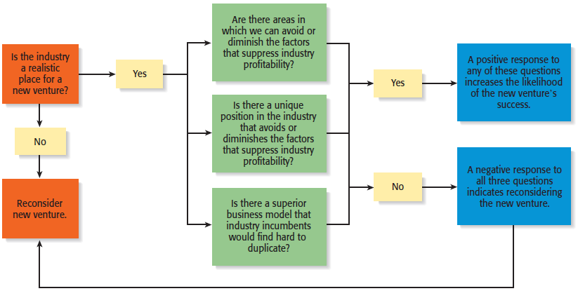
AREC 213 Lecture 6

Slide 34

AREC 213 Lecture 6
Industry Types and the Opportunities They Offer
Emerging Industries
Industries in which standard operating procedures have yet to be developed.
Opportunity: First-mover advantage
Fragmented Industries
Industries that are characterized by a large number of firms of approximately equal size.
Opportunity: Consolidation

Slide 35
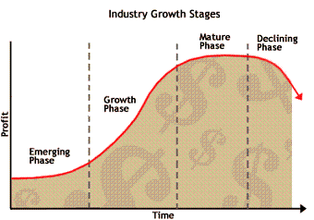
AREC 213 Lecture 6
Industry Types and the Opportunities They Offer
Mature Industries
Industries that are experiencing slow or no increase in demand.
Opportunities: Process innovation and after-sale service innovation
Declining Industries
Industries that are experiencing a reduction in demand.
Opportunities: Leadership, establishing a niche market, and pursuing a cost reduction strategy
Global Industries
Industries that are experiencing significant international sales.
Opportunities: Multidomestic and global strategies

Slide 36
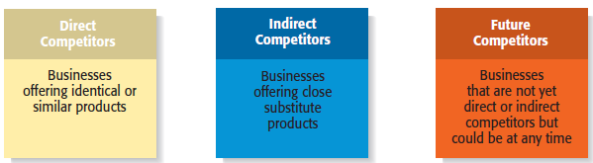
AREC 213 Lecture 6
Competitor Analysis
What is a Competitor Analysis?
A competitor analysis is a detailed analysis of a firm’s competition.
It helps a firm understand the positions of its major competitors and the opportunities that are available.
A competitive analysis grid is a tool for organizing the information a firm collects about its competitors.

Slide 37
AREC 213 Lecture 6
Competitor Analysis
Collecting Competitive Intelligence
To complete a competitive analysis grid, a firm must first understand the strategies and behaviors of its competitors.
The information that is gathered by a firm to learn about its competitors is referred to as competitive intelligence.
A new venture should take care that it collects competitive intelligence in a professional and ethical manner.

Slide 38







AREC 213 Lecture 6
Competitor Analysis
Ethical ways to obtain information about competitors
Attend conferences and trade shows.
Purchase competitors’ products.
Study competitors’ Web sites.
Set up Google and Yahoo! e-mail alerts.
Read industry-related books, magazines, and Web sites.
Talk to customers about what motivated them to buy your product as opposed to your competitor’s product.

Slide 39
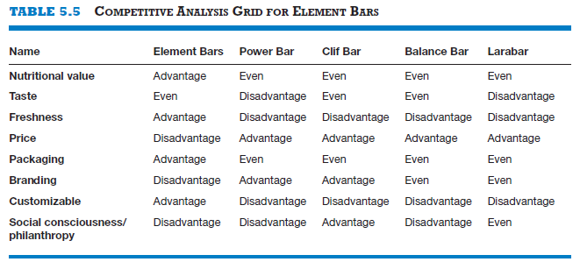
AREC 213 Lecture 6
Competitor Analysis
Competitive Analysis Grid
A tool for organizing the information a firm collects about its competitors
A competitive analysis grid can help a firm see how it stacks up against its competitors, provide ideas for markets to pursue, and identify its primary sources of competitive advantage.

Slide 40
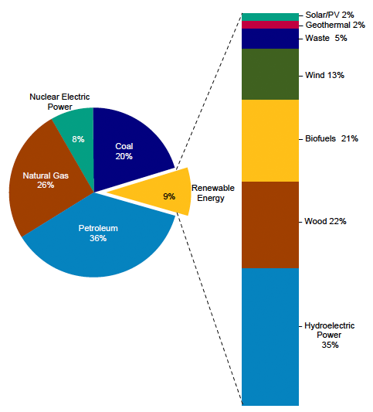
AREC 213 Lecture 6
PESTLE Analysis
Political
Economic
Social
Technological
Legal
Environmental
The Power Industry

Slide 41
Market Analysis

Slide 42
AREC 213 Lecture 6
Market Assessment
Structured approach to defining demand potential
Identify customers
Who
How Many
Where are They
How to Reach them
What motivates them to buy?
How Big is the Market
Is the Market Growing, Stagnant or Shrinking

Slide 43
AREC 213 Lecture 6
Market Assessment
Why Do It?
Understand the Opportunity
Spot Potential Sales
Reduce Business Risk
Plan Your Marketing Approach
Make Informed Decisions
Spot Potential Problems

Slide 44
AREC 213 Lecture 6
Market Assessment
What are you Trying to Learn
How big the Market it
How Fast it is Growing
Who and where the idea customers are

Slide 45
AREC 213 Lecture 6
Market Assessment
The Language of Markets
Segment
Industry
Target Market
Niche Market
Target Customer
Positioning

Slide 46
AREC 213 Lecture 6
Market Segment
The division of broad markets into smaller groups sharing similar needs and attributes
Most broad markets have several distinct segments
Gourmet Chefs vs Cooks
Vegans vs Vegetarians

Slide 47
AREC 213 Lecture 6
Customer Segments
Demographics
Age
Gender
Economic
Income
Spending Habits
Geographic
Location
Where they Buy
Psychographic/Behavioral
Why they Buy
Lifestyle

Slide 48
AREC 213 Lecture 6
Your Target Market
The Segment(s) on which Your Business can Focus
The Segment(s) in which Your Business has an advantage
Your Niche Market

Slide 49
AREC 213 Lecture 6
Target Customer
Those customers who when presented with perfect information about your product or service, along with your competitors will buy yours

Slide 50
AREC 213 Lecture 6
Positioning
How your target customers’ perceive your product vis a vis competing alternatives
Consciously molded by your market strategy
Independently internalized by your customers

Slide 51
AREC 213 Lecture 6
Types of Market Research
Primary (Original Investigation)
Direct Observation
Surveys & Questionnaires
Interviews
Secondary (Use Existing Data)
Internet Searches
Trade Publications
Libraries

Slide 52
AREC 213 Lecture 6
How to do Primary Research
Work in the Industry
Interview Competitors
Act Like a Customer
Surveys & Questionnaires
Give out Samples
Interview
Friends & Family
Potential Customers
Experts

Slide 53
AREC 213 Lecture 6
Secondary Research
Industry reports written by professional research firms and/or associations
Industry Overview & Snapshot
Where is the Market Going?
Overall Growing or Shrinking?
Limitations
Not local market specific
Not product specific
Cannot query

